Slide 1
Cross-Domain Self-supervised Multi-task Feature Learning using Synthetic Imagery
Zhongzheng Ren
University of Illinois Urbana-Champaign (UIUC)
CVPR 2018 work with Yong Jae Lee (UC Davis)
[Most of the slides are from Yong Jae Lee]

Slide 2
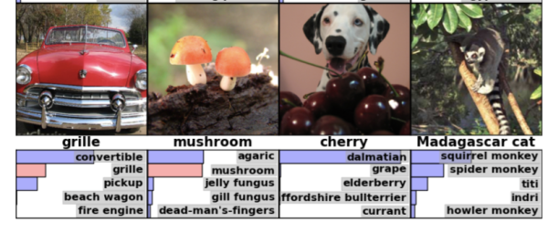
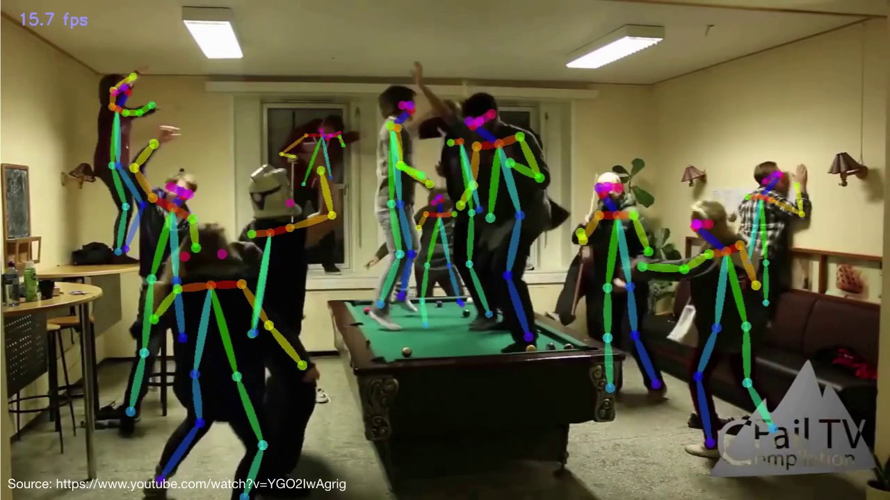
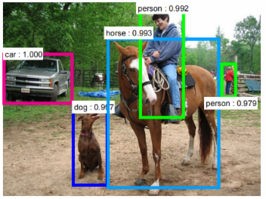
Success in modern visual recognition
Image classification
Semantic segmentation
… and many more
Pose recognition
Object detection

Slide 3
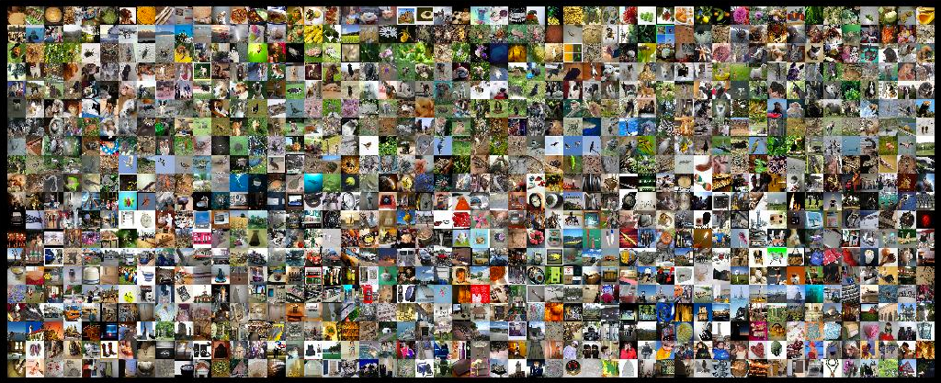
Standard recognition pipeline today
1. Pre-train on a large labeled dataset to learn transferrable features
2. Fine-tune on the related (smaller) task dataset
Labeling is expensive and introduces bias

Slide 4
Can we learn transferable features without human annotations?

Slide 5
Supervised vs. Self-supervised learning
Supervised
training
x
Deep Net
label y
Predicting data from data
Self-supervised
training
x₀
Deep Net
x₁

Slide 6
These self-supervised methods learn from a single task
[Slide credit: Richard Zhang]

Slide 7
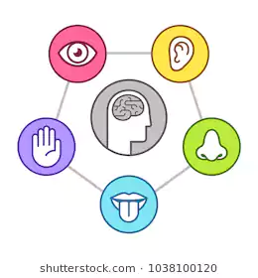
Humans learn from multiple sources jointly
Learning new objects and environments
Learning new languages

Slide 8
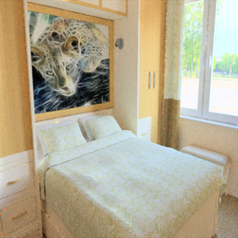
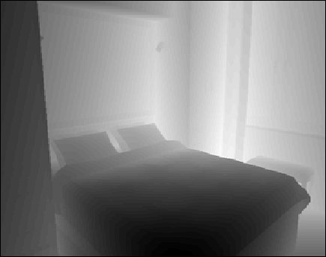
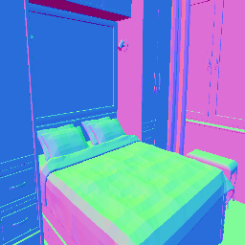
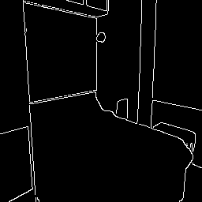
Key idea: Multi-task self-supervised learning
RGB Image
Learn transferable semantic features
without human annotations
Depth
Surface
Normal
Instance
Contours

Slide 9
Obtaining accurate, multiple sources of information for real images is difficult

Slide 10
Key idea: Multi-task self-supervised learning using synthetic imagery
Use synthetic images and their various free annotations
Key advantages of using synthetic data:
Easy to render, more realistic than ever
User has full control of a virtual world
CG industry for e.g. games/movies is huge and continuously growing

Slide 11
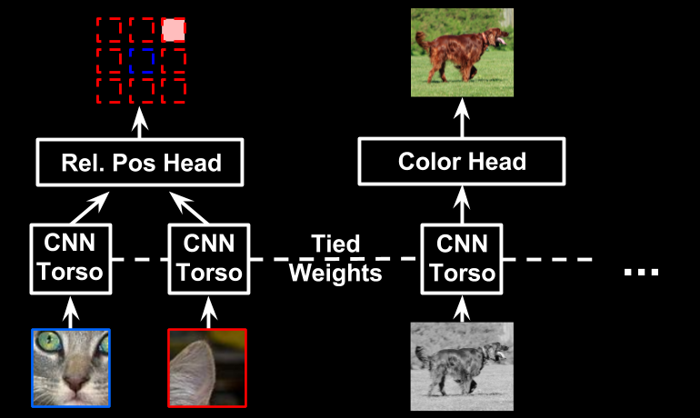
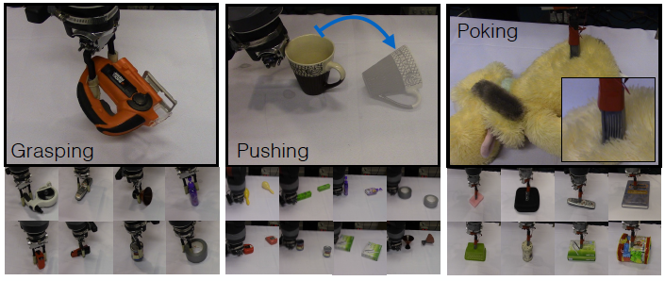
Related multi-task self-supervised learning work
Previous multi-task works are either complex or limited to robotics table-top settings
Concurrent multi-modal work on audio-visual self-supervised learning [Arandjelović & Zisserman ‘17, Owen & Efros ‘18, Zhao et al. ‘18, …]
[Doersch & Zisserman ‘17]
[Pinto et al. ’16]

Slide 12
Approach

Slide 13
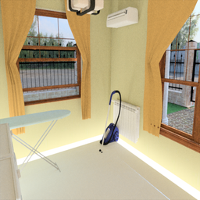
Network architecture
Synthetic
Edge
Base
Surface
normal
Depth
Input: Synthetic RGB image
Output: Instance contours, surface normal, depth
Use blue blocks for transfer learning

Slide 14
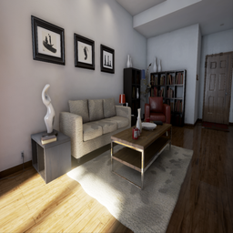
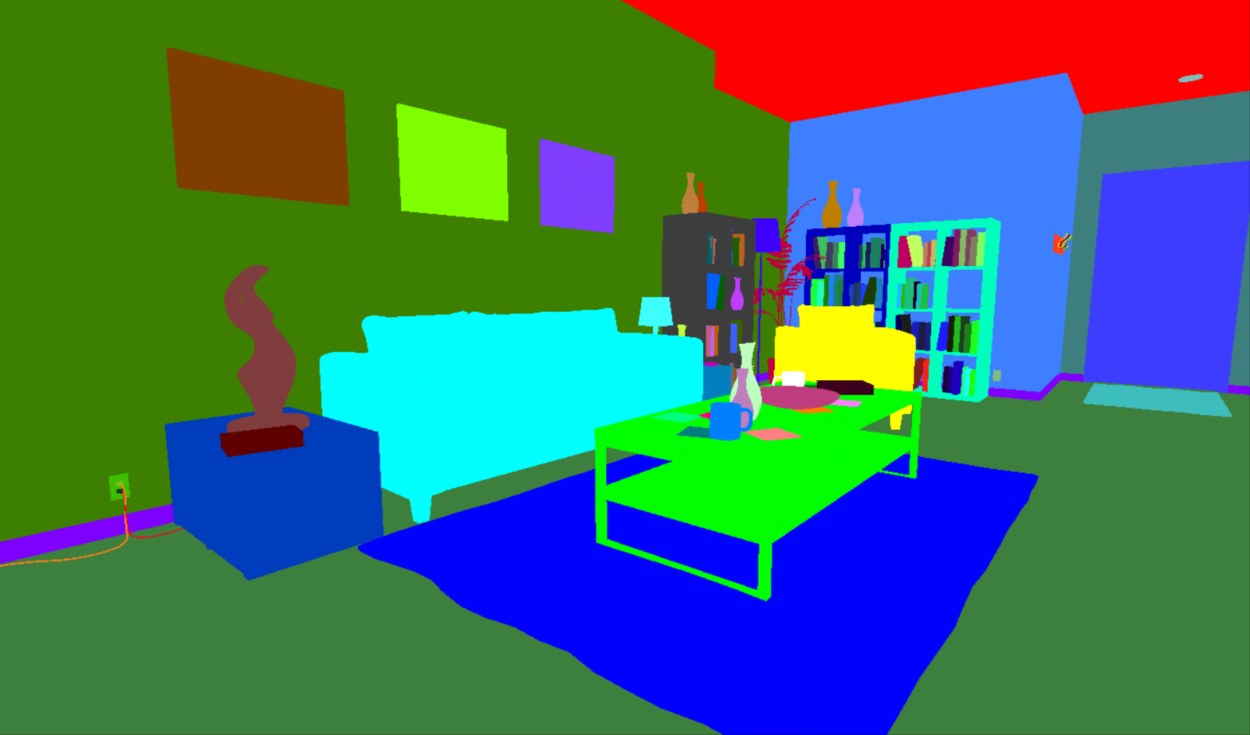
Task 1: Instance contour detection
Synthetic data ground-truth instance segmentation masks are accurate
But labels are noisy, inconsistent (e.g., “chair1”, “furniture”)

Slide 15
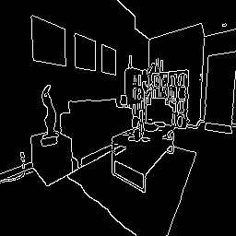
Task 1: Instance contour detection
Solution: Rather than segment objects, detect semantic (binary) edges
Canny edge detection on GT instance segmentation masks

Slide 16
Task 1: Instance contour detection
Edge detection: Balanced sigmoid cross entropy loss [Xie & Tu ’15]

Slide 17
Task 2: Depth prediction
Ground-truth depth map extracted from a synthetic scene is clean, accurate
Requires understanding high-level semantics about objects and their relative placements in a scene

Slide 18
Task 2: Depth prediction
Depth prediction: Scale-invariant depth prediction loss [Eigen et al. ’14]

Slide 19
Task 3: Surface normal prediction
Surface normal prediction: Inverse dot-product loss [Eigen et al. ’14]

Slide 20
Network architecture
Synthetic
Edge
Base
Surface
normal
Depth
Input: Synthetic RGB image
Output: Instance contours, surface normal, depth
Use blue blocks for transfer learning

Slide 21
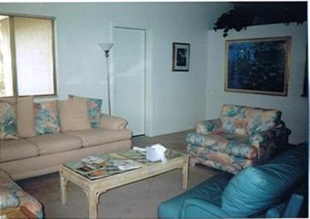
How to deal with the domain difference between real and synthetic images?
Synthetic
Real

Slide 22
Unsupervised feature-level domain adaptation
Shared weights
Synthetic
Edge
Base
Surface
normal
Depth
Real world
Base
Domain
D
Real / Synthetic
Discriminator D tries to discriminate real vs. synthetic features
Base network in turn tries to generate features which fool D

Slide 23
Results

Slide 24
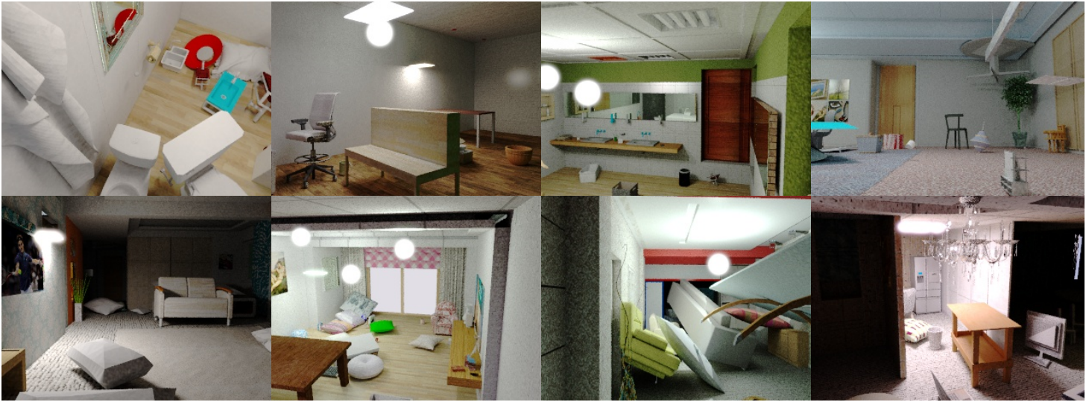
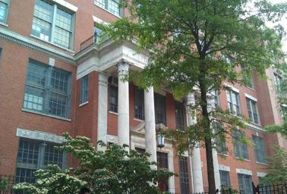
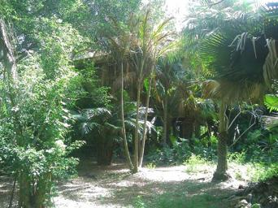
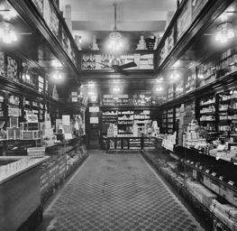
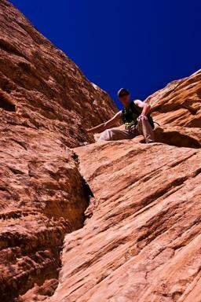
Datasets
Synthetic data used for self-supervised feature learning
Real data used for unsupervised domain adaptation
SUNCG [Song et al. ‘17] (0.5M)
SceneNet RGB-D [McCormac et al. ‘17] (1M)
Places365 [Zhou et al. ‘16]
1.8M images of scenes

Slide 25
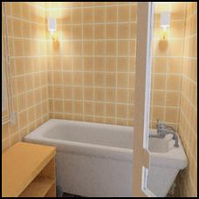
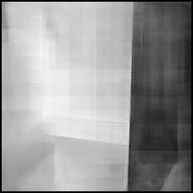
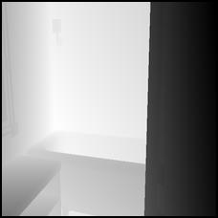
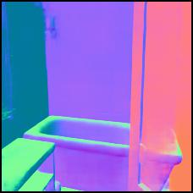
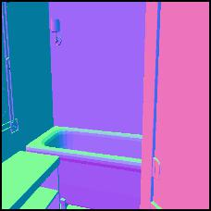
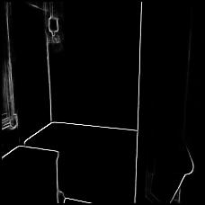
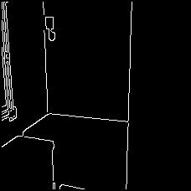
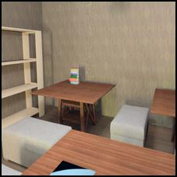
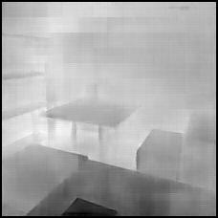
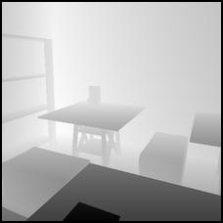
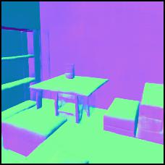
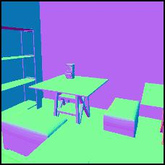
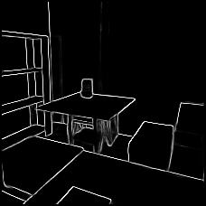
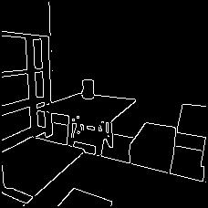
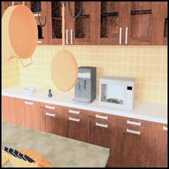
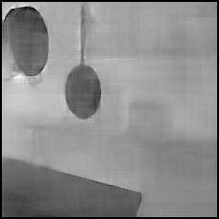
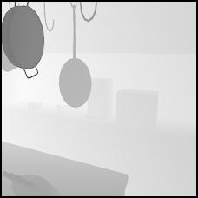
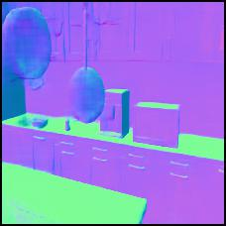
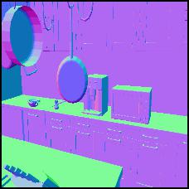
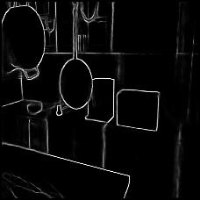
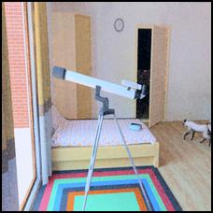
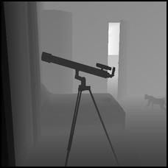
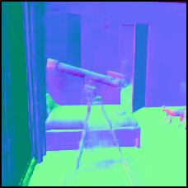
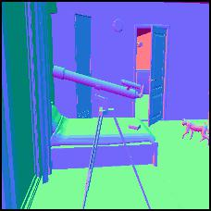
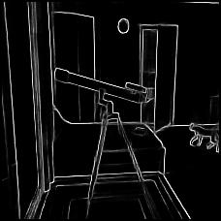
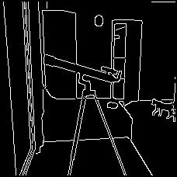
Qualitative task prediction results
Synthetic
RGB
Depth
Pred.
Depth
GT
S Normal
Pred.
S Normal
GT
Edge
Pred.
Edge
GT
The better our model performs on these tasks, the better transferable features it is likely to get

Slide 26
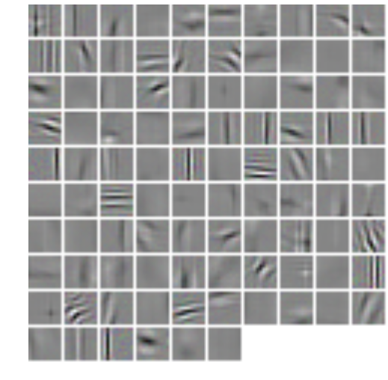
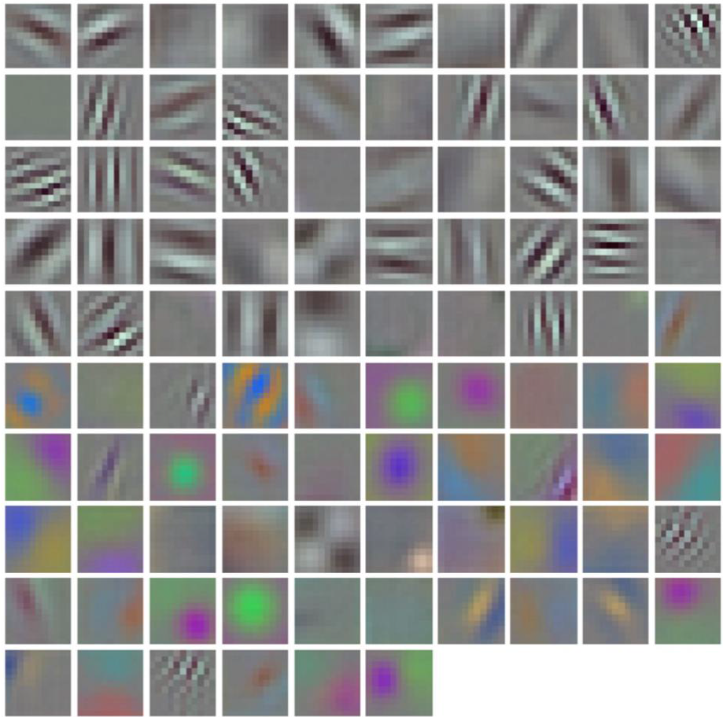
Learned conv1 filters
Ours (self-supervised)
ImageNet (human-supervised)
Our model learns conv1 features that resemble gabor-like filters

Slide 27
How well does our network generalize to new unseen
data and tasks?

Slide 28
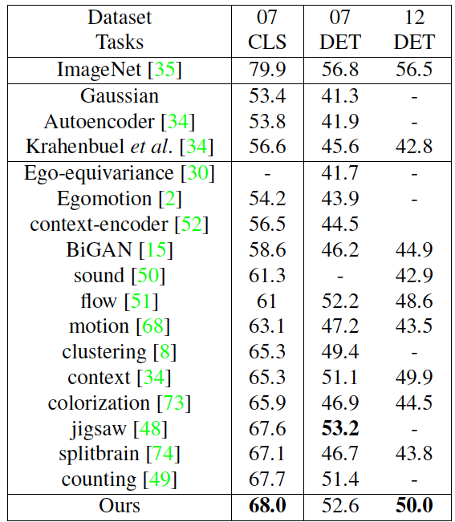
PASCAL
transfer learning
Pre-train on synthetic data, fine-tune on real images
Classification (AlexNet) and detection (Fast-RCNN)
Shows promise of using synthetic data and its free annotations for self-supervised feature learning

Slide 29
Ablation studies: Does multi-task learning help?
Tasks are complementary and multi-task learning is beneficial for feature learning

Slide 30
Ablation studies: Does domain adaptation help?
Domain adaptation at a mid-level layer such as conv5 results in the best performance

Slide 31
Ablation studies: Does more data help?
Increasing synthetic dataset from 0.5M to 1.5M images -> 0.6-0.8% point improvement for classification and detection

Slide 32
Conclusions
Novel self-supervised visual feature learning approach
Multi-task learning
Synthetic data
Code, additional results available:
https://jason718.github.io/project/cvpr18/main.html
Paper list of Self-supervised learning:
https://github.com/jason718/awesome-self-supervised-learning

Slide 33
Thank you!

